Slide 1
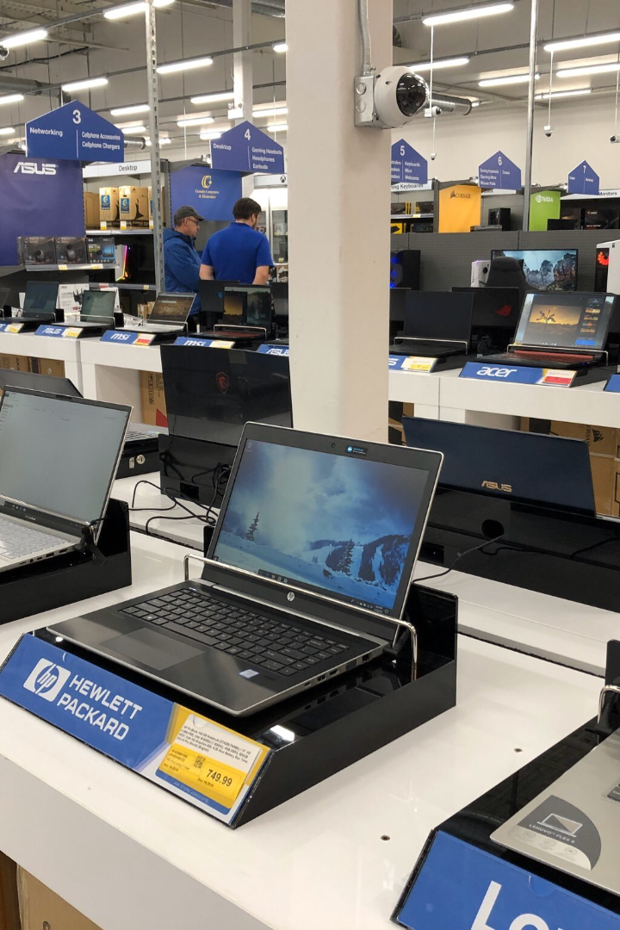

Creating an Electronics Store: Gadget Galaxy
Discover how to build Gadget Galaxy, an innovative ecommerce store powered by Next.js, Sanity.io, Stripe, and deployed on Vercel.

Slide 2

Designing the User Interface
Wireframing
Responsive Design
Visual Branding
Create intuitive layouts and navigation structures that facilitate an exceptional shopping experience.
Ensure Gadget Galaxy looks stunning and functions flawlessly on any device or screen size.
Craft a stylish and consistent visual identity that resonates with tech-savvy customers.

Slide 3



Technology Stack
A headless CMS that allows for efficient content management and seamless integration with Next.js.
A powerful and flexible JavaScript framework for building high-performance web applications.
A secure and reliable payment processing platform, ensuring smooth transactions for Gadget Galaxy customers.

Slide 4

Next.js: Powering Our E-Commerce Website
Next.js is our go-to framework for building fast, scalable, and SEO-friendly e-commerce websites. With its server-side rendering capabilities, we deliver a seamless shopping experience to our customers. The flexibility and performance of Next.js enable us to create highly interactive and dynamic product pages, ensuring a delightful shopping journey for every visitor.

Slide 5

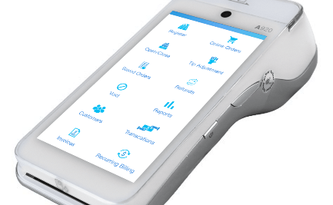

Implementing Stripe for Payment Processing
Secure Transactions
Payment Handling
Data Security
Enable customers to purchase products using Stripe's secure and reliable payment gateway.
Effortlessly process transactions, handle refunds, and manage customer payment details.
Utilize Stripe's robust encryption and fraud detection mechanisms to safeguard sensitive information.

Slide 6
Integrating Sanity.io for Content Management
1
Data Modeling
Design a flexible content schema to organize product information, blog posts, and other site content.
Content Creation
2
Add and manage products, blog articles, and other content using the Sanity.io CMS.
3
API Integration
Connect Next.js and Sanity.io to fetch and display content dynamically across the Gadget Galaxy site.

Slide 7

Deploying the Store on Vercel
1
One-Click Deployment
Effortlessly deploy the Gadget Galaxy store on the Vercel platform with just a few clicks.
2
Simplified Scaling
Seamlessly scale the store as the customer base grows, without worrying about infrastructure management.
3
Fast Loading Speeds
Benefit from Vercel's global CDN to ensure lightning-fast page load times for a smooth user experience.

Slide 8

Testing and Launching the Gadget Galaxy Store
Thoroughly test the website's functionality, usability, and performance before the highly anticipated launch. Prepare for success!

Slide 9
GROUP MEMBERS
PC 23 DEVANSHU SURANA
PC 26 PRANAV PISAL
PC 30 ABHILASH KASHID
PC 32 PRACHITI KULKARNI

Slide 10
THANKS

